Slide 1

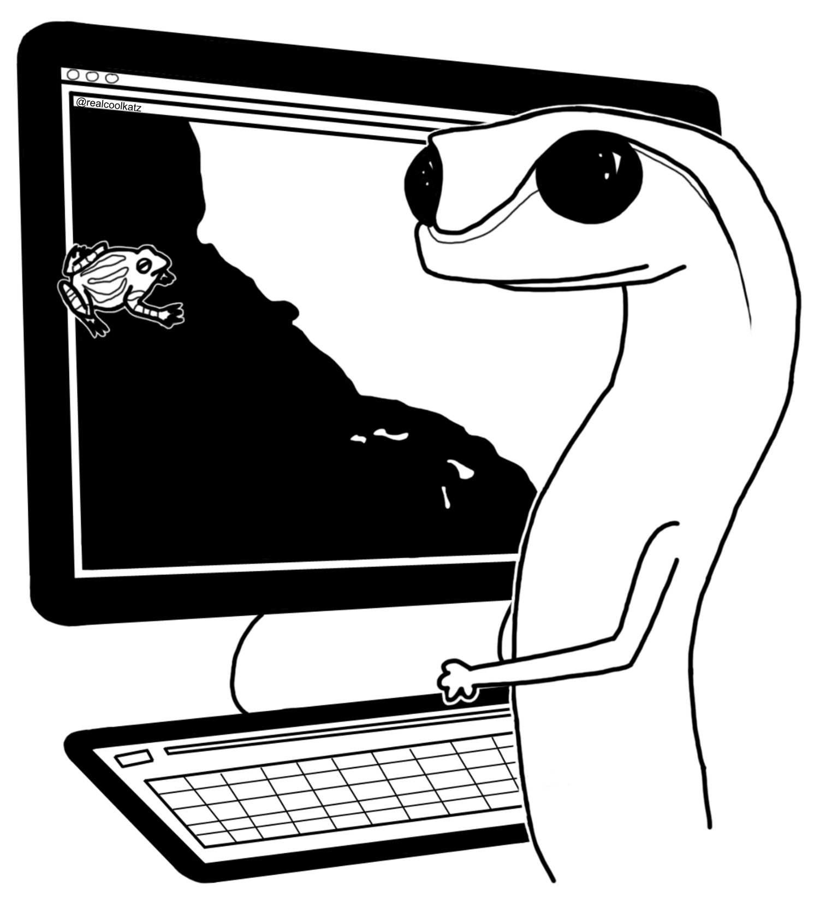
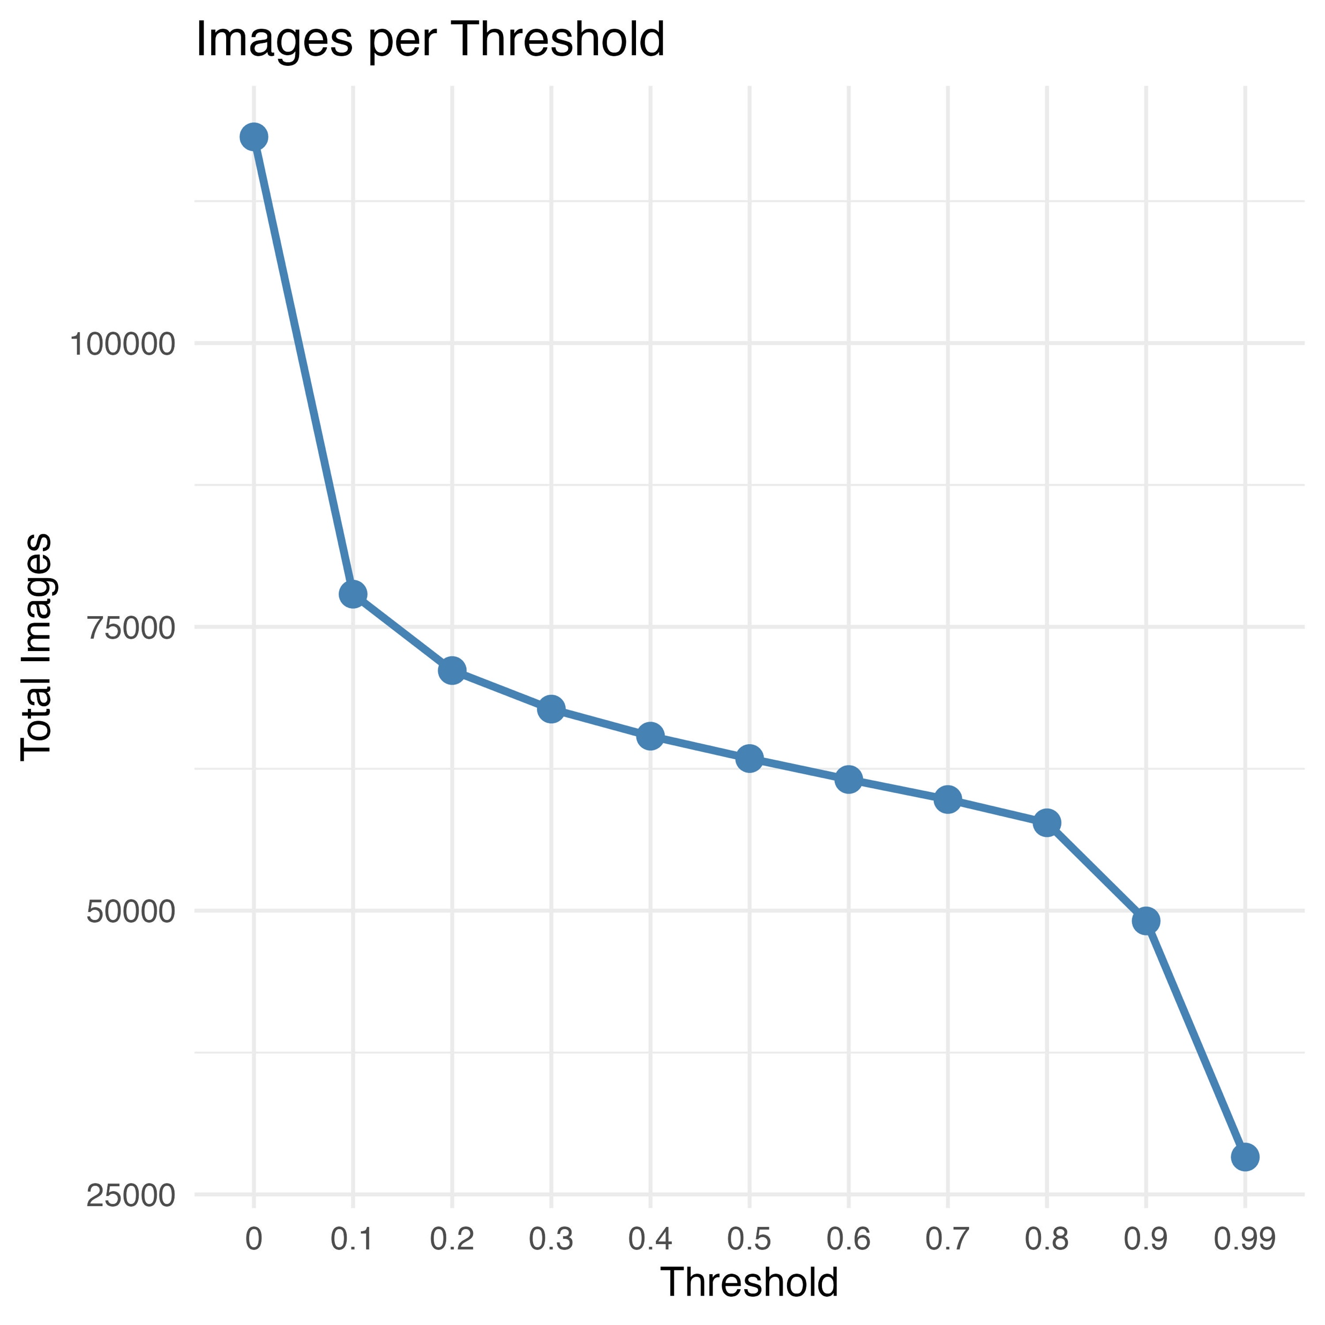
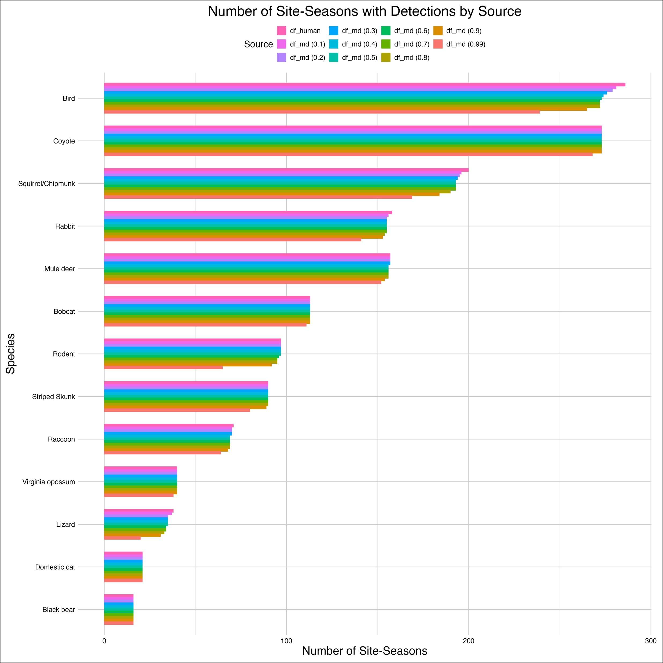
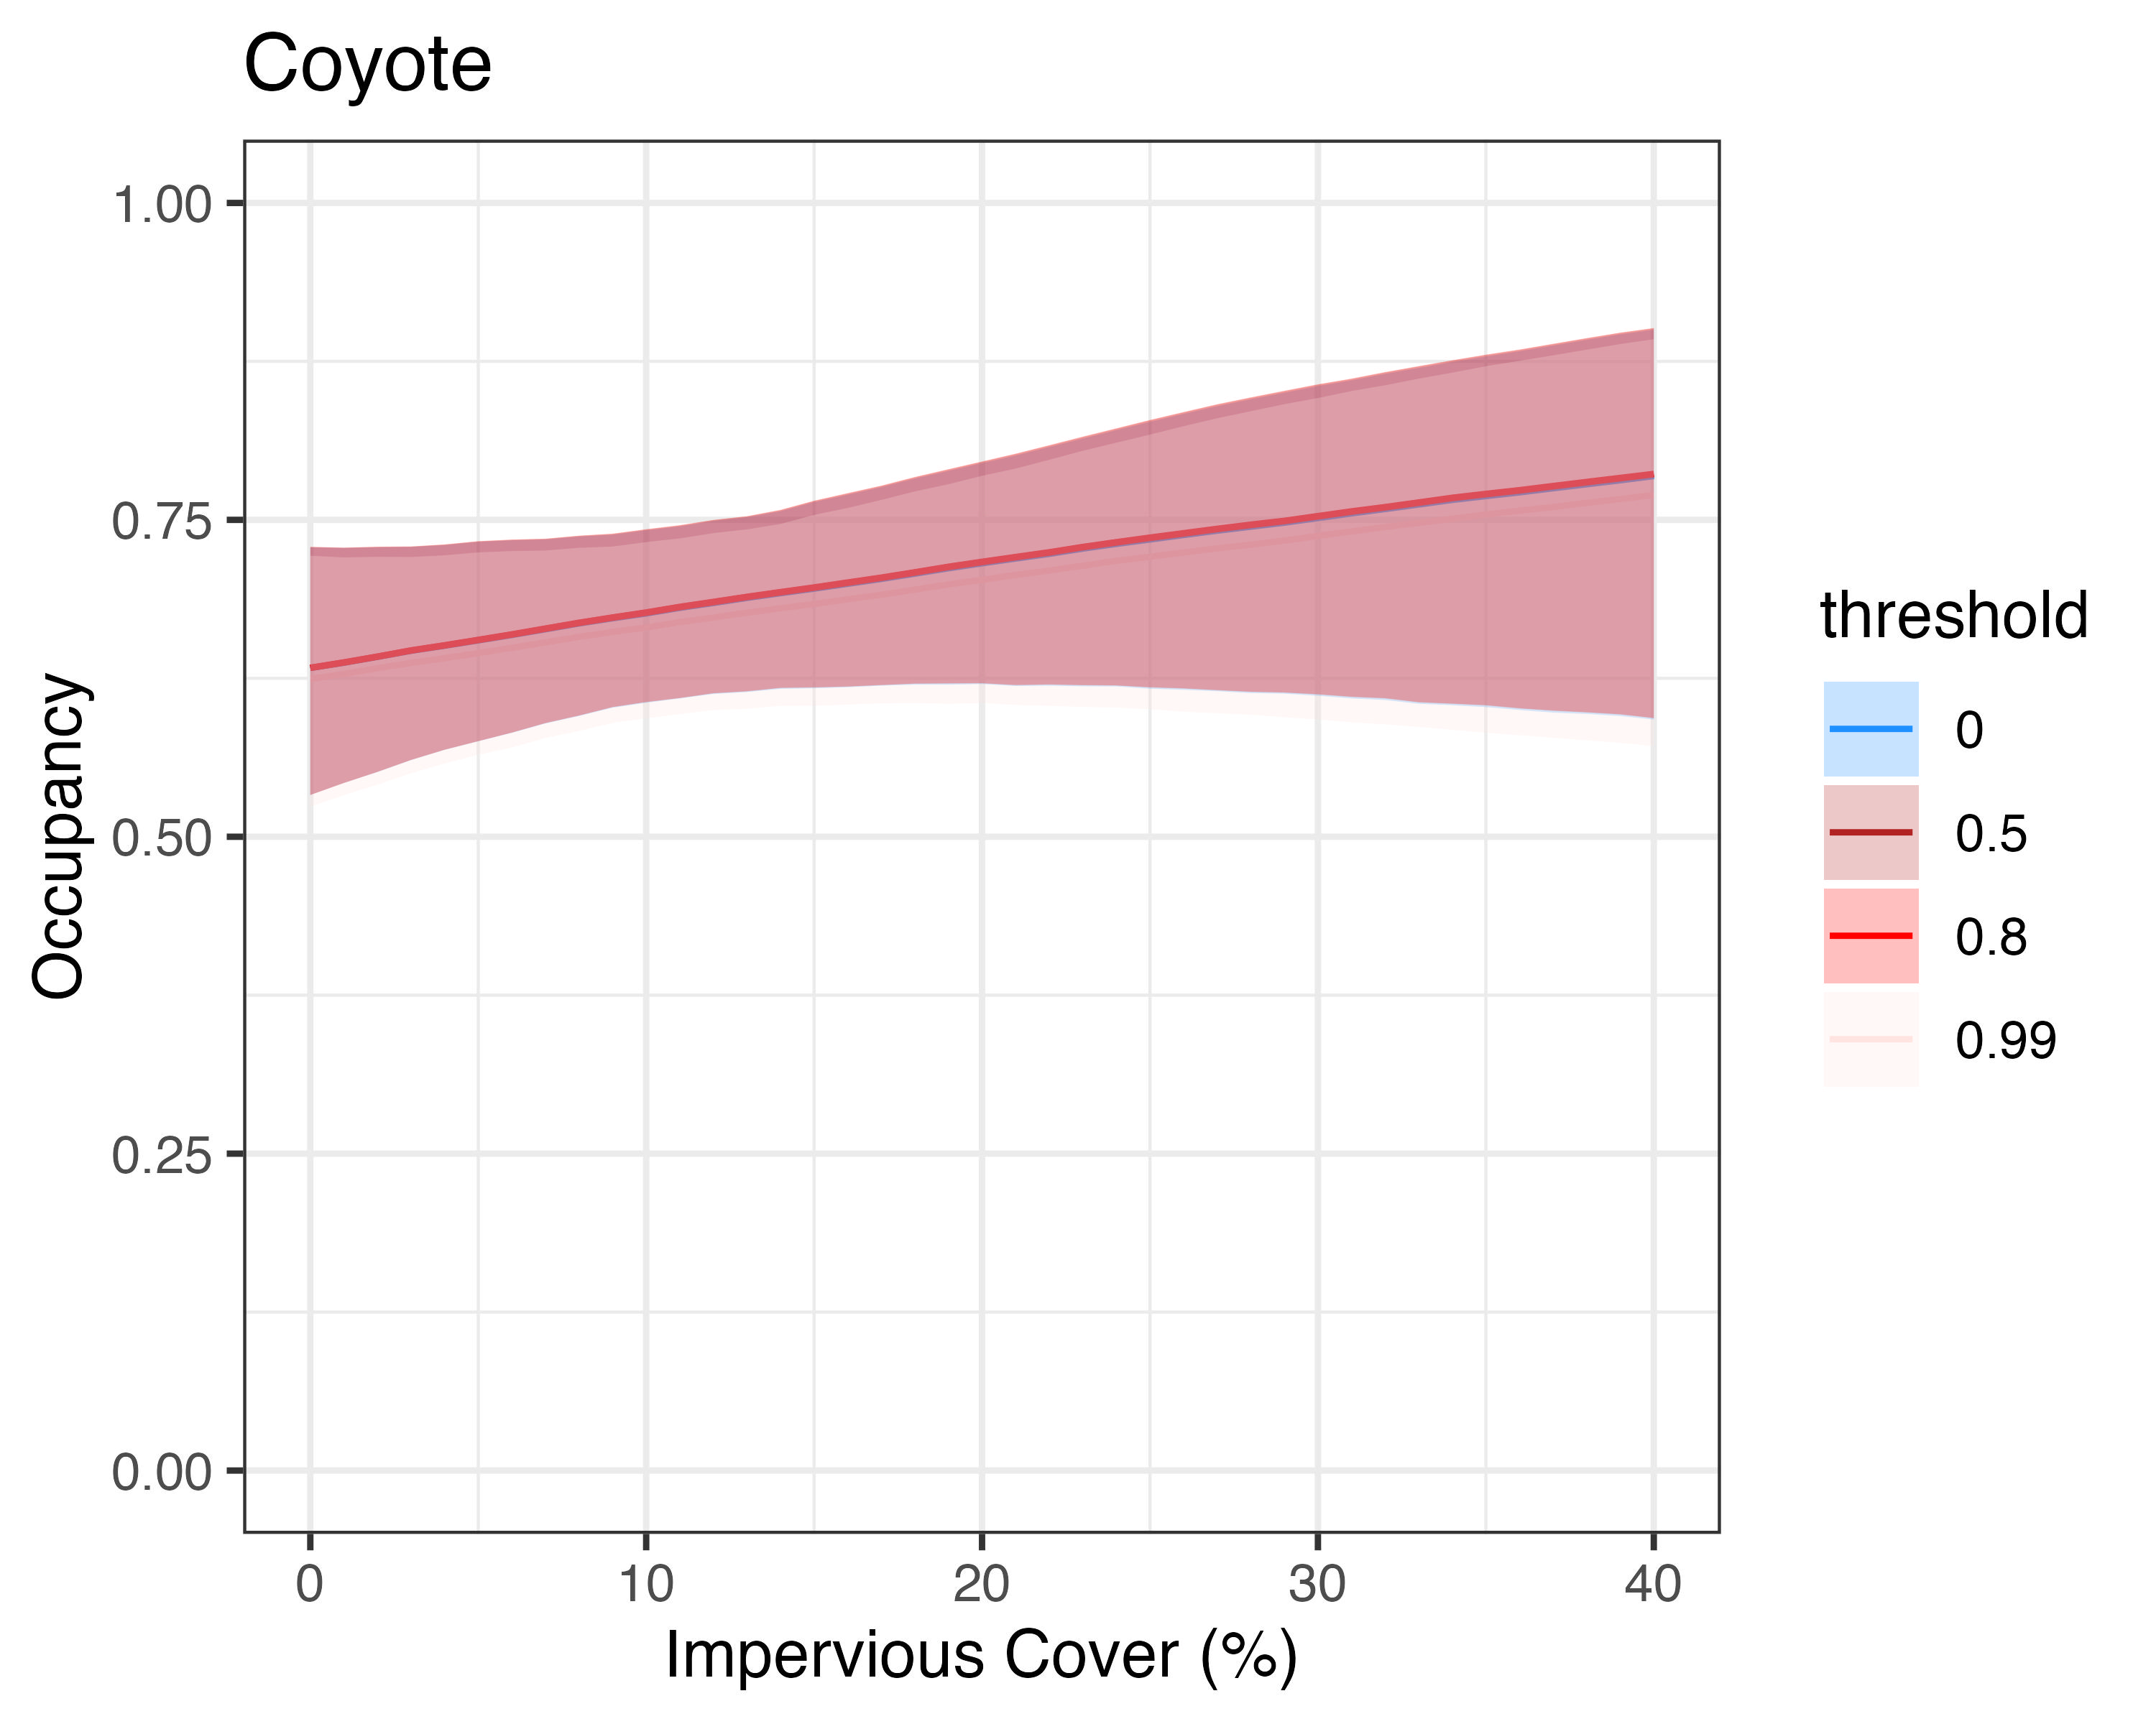
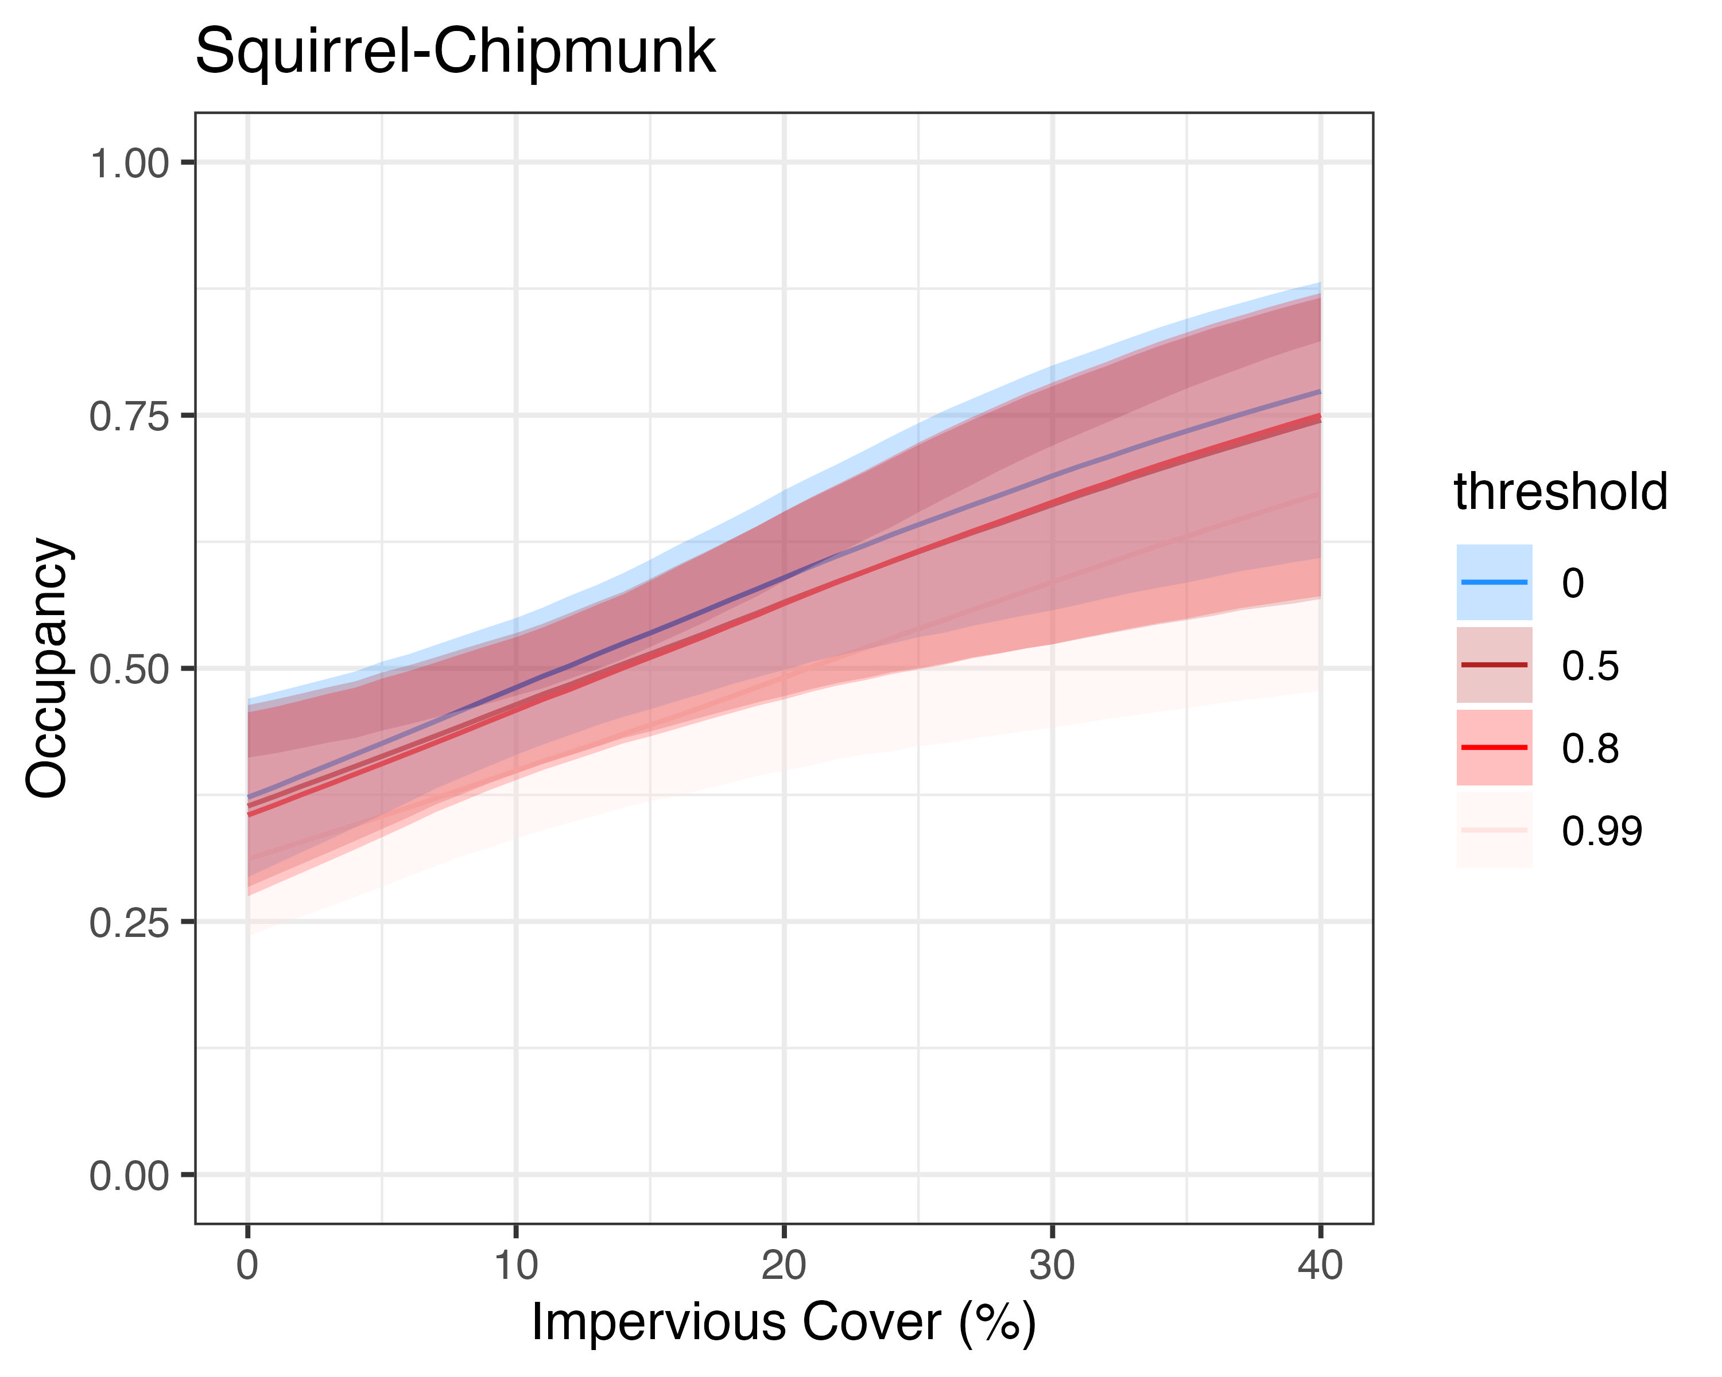
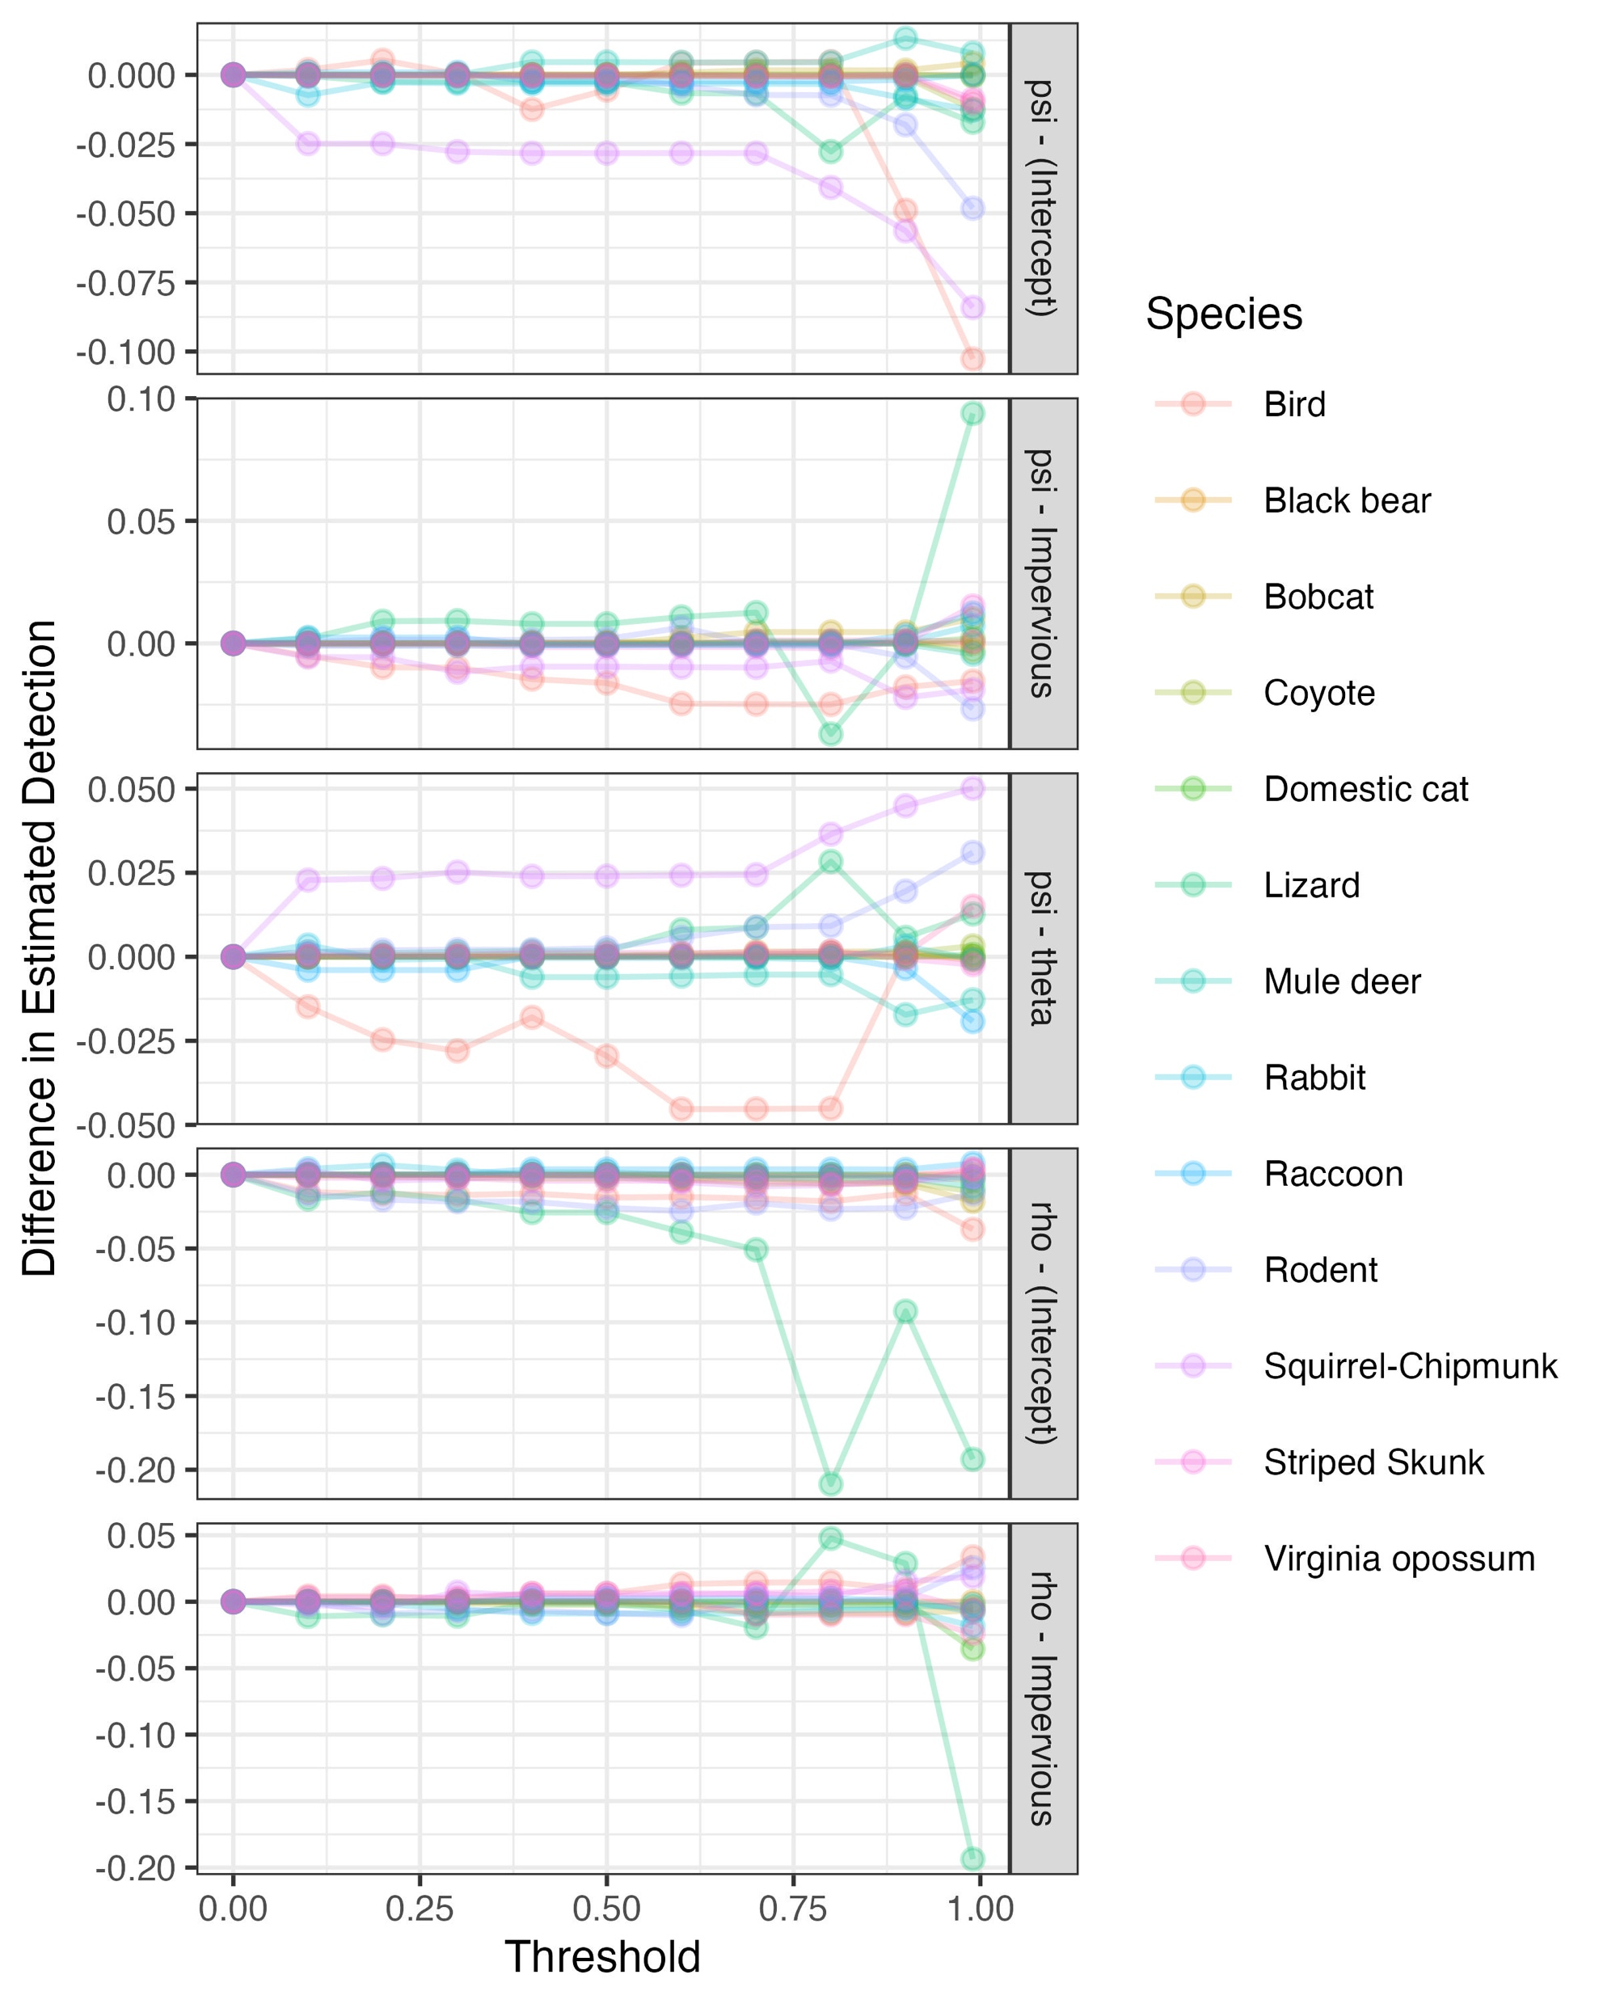
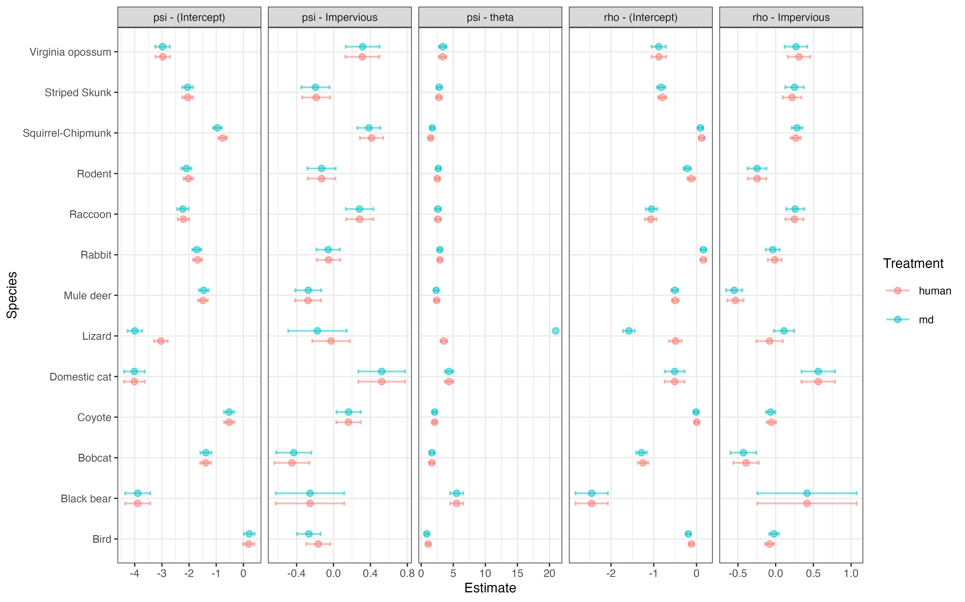
The Big Picture: Does AI Image Classification
Affect Occupancy Estimates of Urban Wildlife?
Ethan Schoen¹, Tiziana Gelmi², Maya Gonzalez¹, Hector Baez¹, Max Yusuda¹, Mason Fidino², Amanda Zellmer¹
¹Department of Biology, Occidental College, Los Angeles, CA 90042; ²Conservation and Science Department, Lincoln Park Zoo, Chicago, IL 60614
Introduction
Results
Varying confidence thresholds for MegaDetector detection did not have a large impact on the number of Seasons a species was observed
Conclusion
Camera traps are a key tool in wildlife monitoring
However, they pose a significant challenge of processing millions of photos – most of which contain no animals
Ecologists are increasingly turning to machine learning tools like MegaDetector to automatically identify images
Integration of these tools into ecological workflows raises critical questions:
How reliable are AI-generated classifications for scientific analysis?
What are the trade-offs of using AI in place of human review?
The number of images that are removed at each confidence threshold (much less human review required)
Our results suggest that data loss caused by the use of AI tools like MegaDetector does not have a significant impact on the results of common occupancy analysis approaches for most species.
While some minor variations were observed across different thresholds, the core ecological insights remained consistent. Although use of AI classifiers should continue to be monitored in ecological settings – particularly for smaller species which may show greater sensitivity – these tools have demonstrated considerable promise in their ability to substantially reduce manual labor and maintain reliability.
Data loss caused by different confidence thresholds did not significantly alter occupancy model results
Differences in occupancy model parameters over increasing confidence thresholds were minor
Methods
Acknowledgements
Compiled human-labeled images from 2018-2024
From 71 sites around Pasadena, California
20 species-groups analyzed
Ran each image through MegaDetector, observing confidence of each image containing wildlife
Subset for confidence thresholds from {0.0, 0.1, … 0.8, 0.9, 0.99}
Compared to all human-labeled data
Trained an auto-logistic model for each threshold, using imperviousness as a covariate
Measured difference between threshold groups for parameter values
I would like to thank Occidental College, the Computational Biology Lab, and the Urban Wildlife Information Network (UWIN) for their support and resources.
Special thanks to Mason Fidino for his valuable guidance, expertise on analytical approaches, and thoughtful feedback during critical stages for this project.
I am especially grateful for Professor Amanda Zellmer for her ongoing mentorship, insight, and encouragement throughout this work, as well as her patience and dedication to helping me develop as a researcher.
Even at high thresholds for animal detection confidence (0.8), occupancy model parameters remain mostly unchanged

